Slide 1

Exploring Mobility Patterns in Metropolitan Melbourne (June 2018-June 2022)
Tao Ma, Henry Leighton, Owen Johannes, Jai Gupta, Tattwamasi Ray

Slide 2

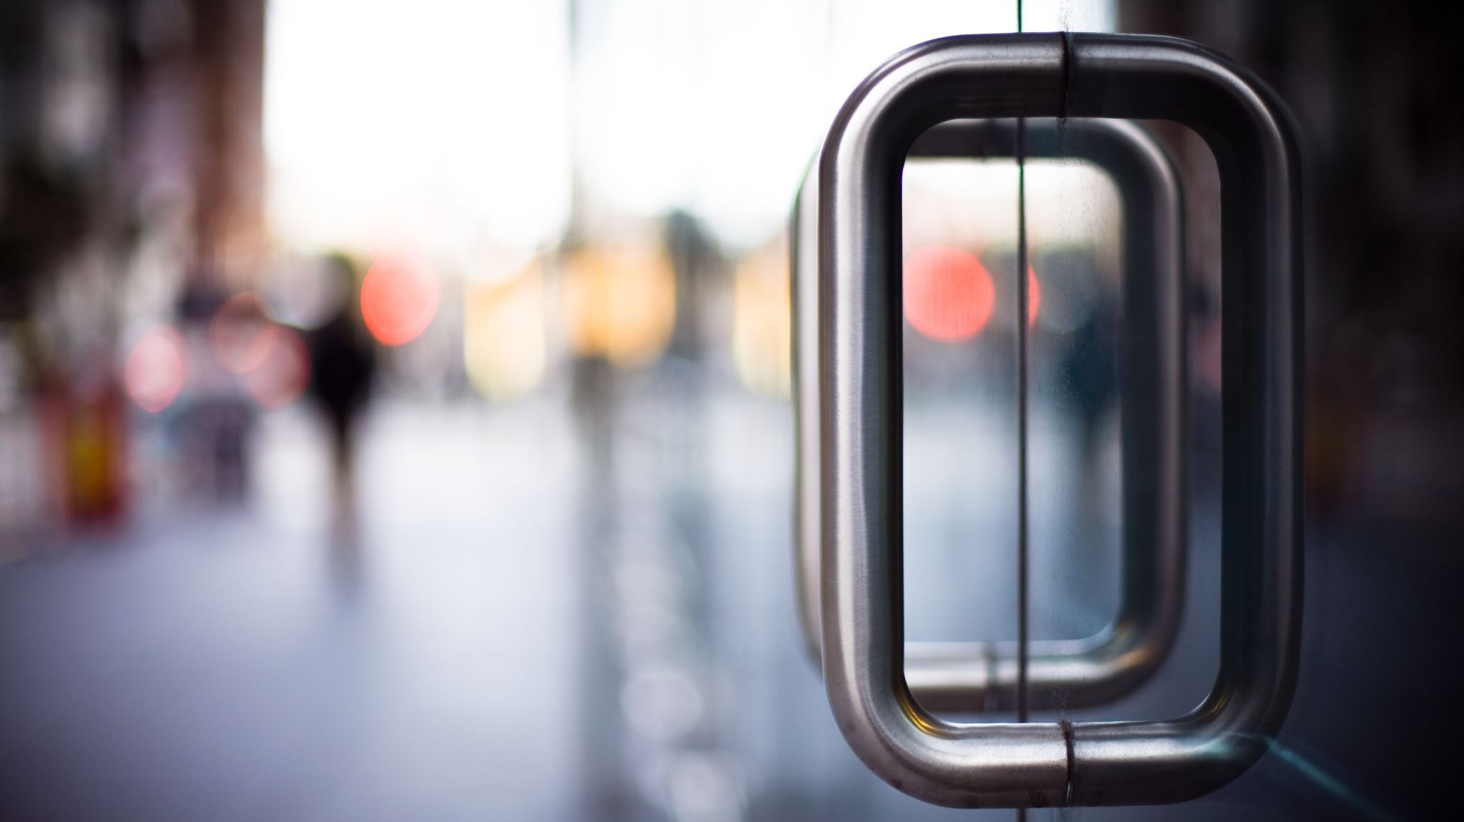
Project Description
The COVID-19 pandemic has had a profound impact on many aspects of life, including transportation and mobility. With the introduction of various restrictions and lockdowns, people have had to adapt their travel behaviors and routines, leading to significant changes in mobility patterns. This study aims to investigate how mobility patterns in Metropolitan Melbourne have evolved from June 2018 to June 2022, with a focus on the impact of the pandemic.

Slide 3
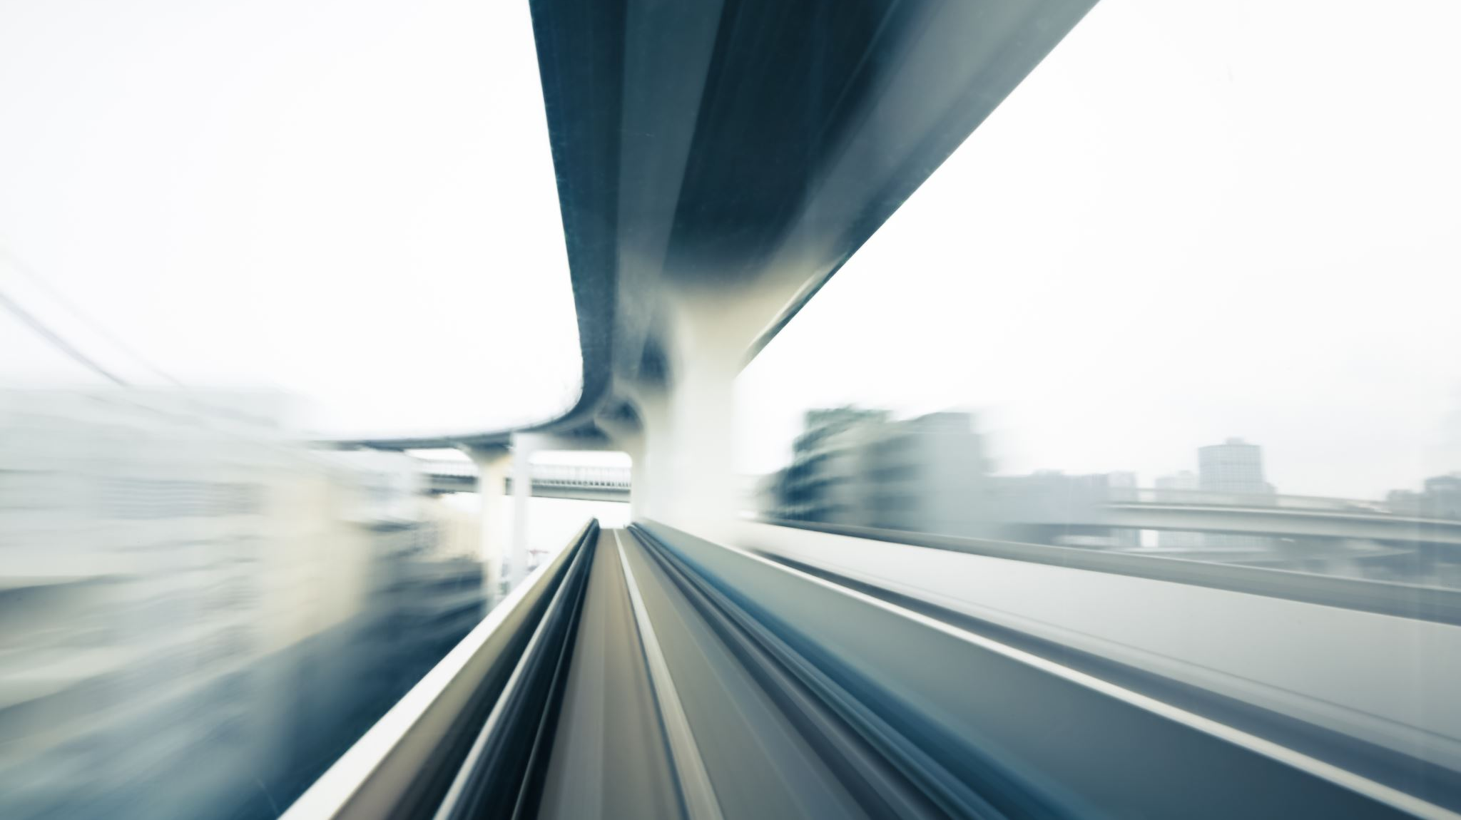
Our Questions
How has each of the different modes of public transport increased or decreased in usage in light of the pandemic? – Henry
Which municipality saw the greatest change in public transport usage, and which station saw the greatest change in the City of Melbourne? - Tao
Did the pandemic affect the peak hours of train usage in Metropolitan Melbourne? - Jai
How has the volume of pedestrian traffic in Melbourne’s CBD evolved over the time frame? - Owen

Slide 4
Datasets to be used
PTV CSV’s from the discover.data.vic.gov.au website
Pedestrian Counting System API (City of Melbourne’s Open Data API)
Victorian Coronavirus Data

Slide 5
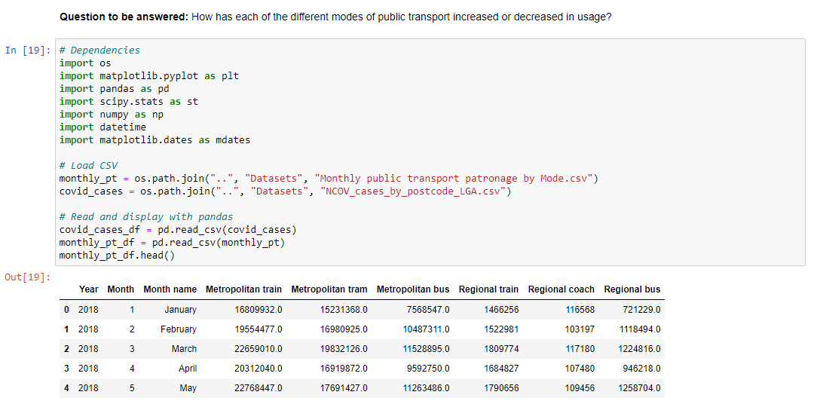
How has each of the different modes of public transport increased or decreased in usage in light of the pandemic?

Slide 6
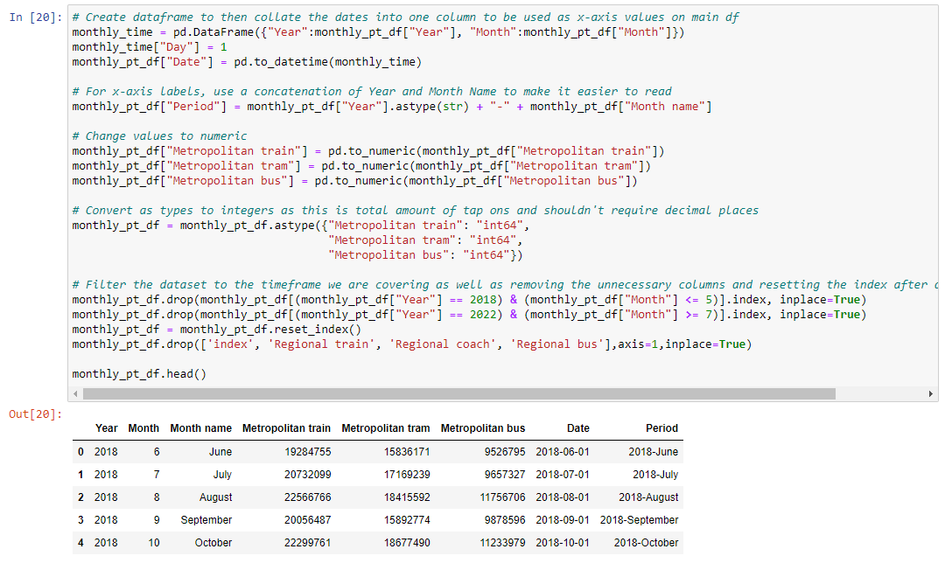
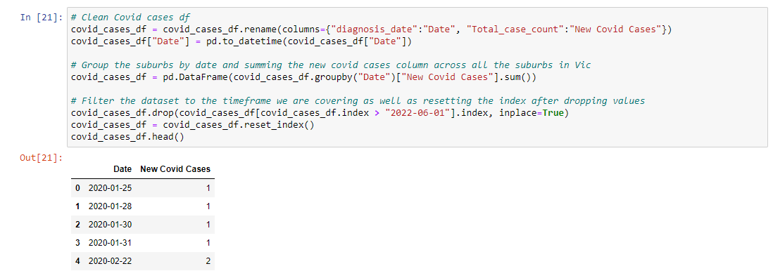
How has each of the different modes of public transport increased or decreased in usage in light of the pandemic?

Slide 7
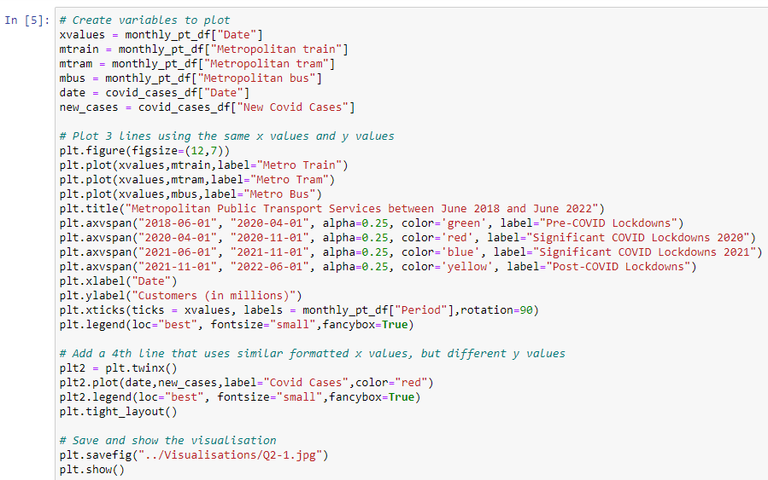
How has each of the different modes of public transport increased or decreased in usage in light of the pandemic?

Slide 8
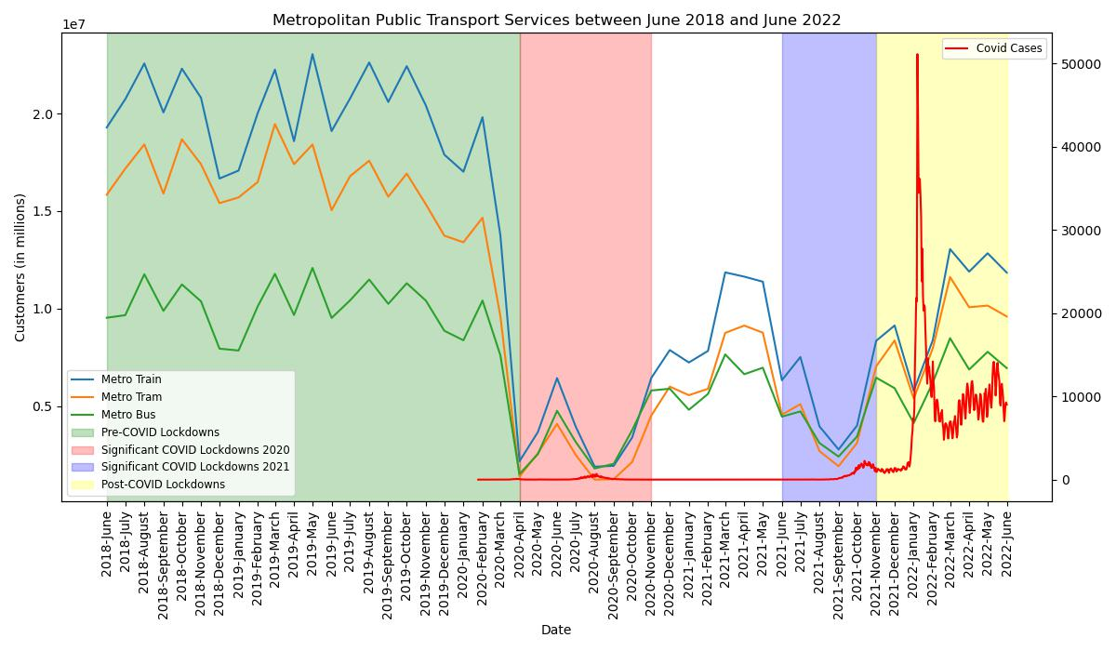
How has each of the different modes of public transport increased or decreased in usage in light of the pandemic?

Slide 9
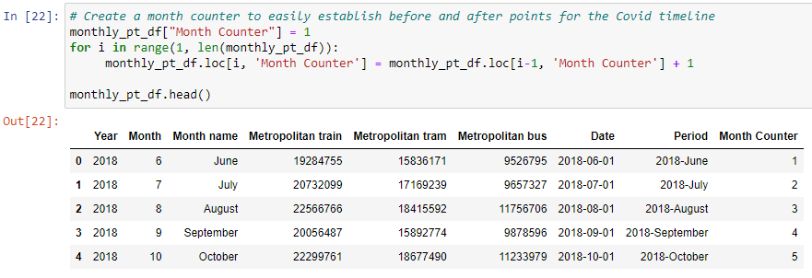
How has each of the different modes of public transport increased or decreased in usage in light of the pandemic?

Slide 10
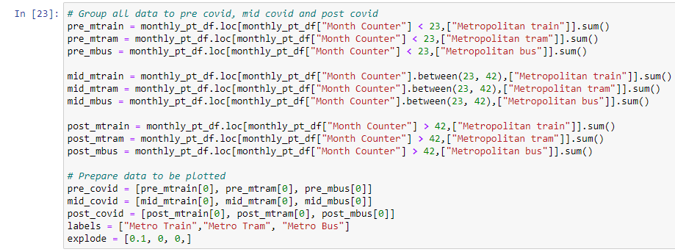
How has each of the different modes of public transport increased or decreased in usage in light of the pandemic?

Slide 11
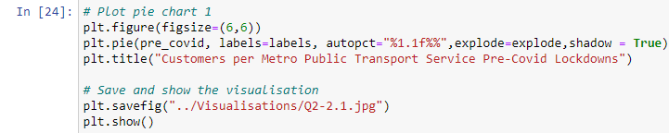
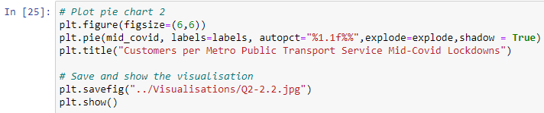
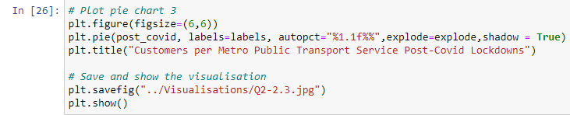
How has each of the different modes of public transport increased or decreased in usage in light of the pandemic?

Slide 12
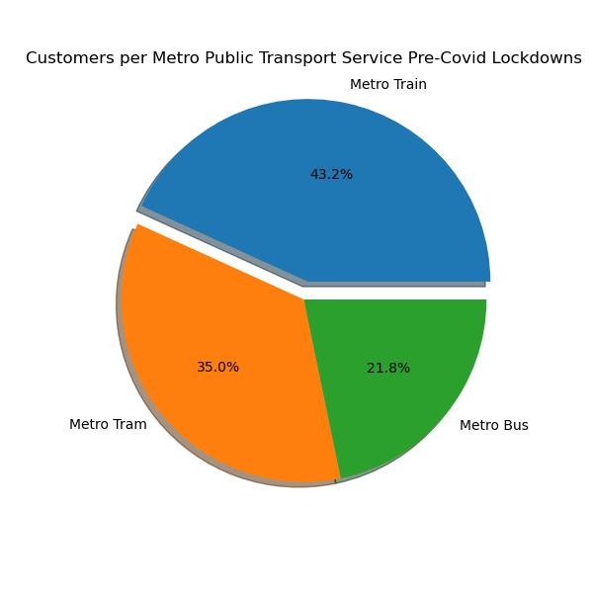
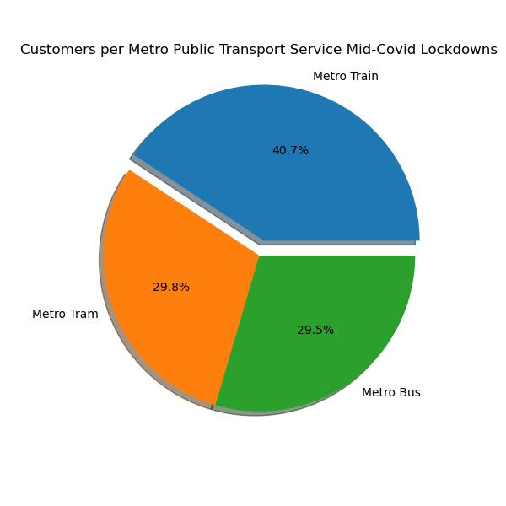
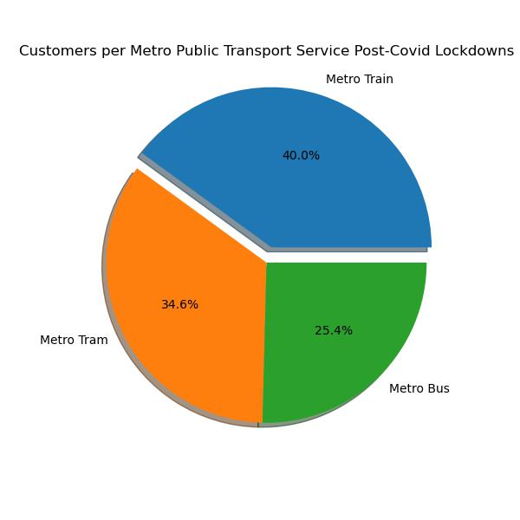
How has each of the different modes of public transport increased or decreased in usage in light of the pandemic?

Slide 13
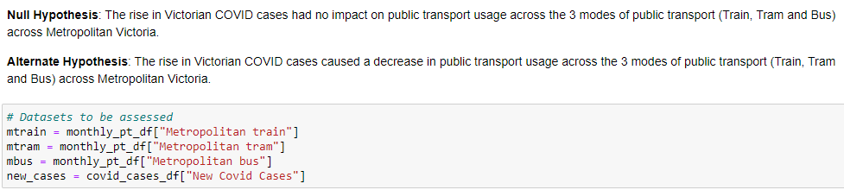
How has each of the different modes of public transport increased or decreased in usage in light of the pandemic?

Slide 14
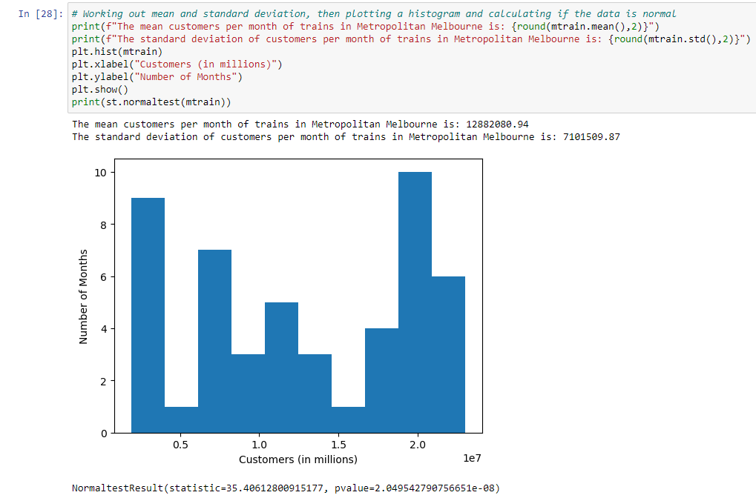
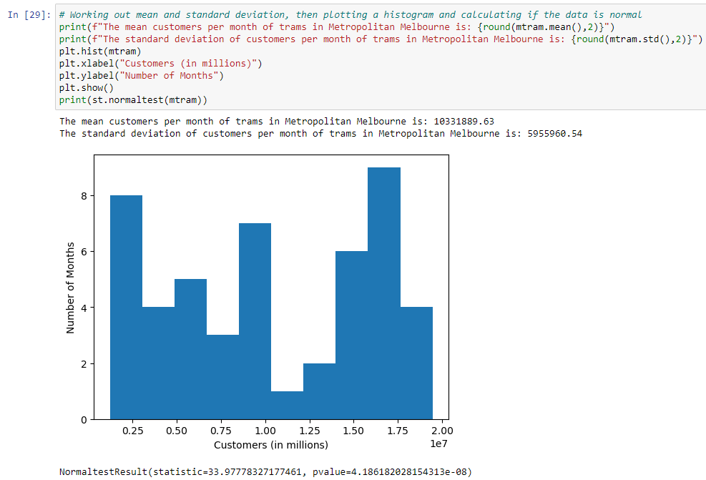
How has each of the different modes of public transport increased or decreased in usage in light of the pandemic?

Slide 15
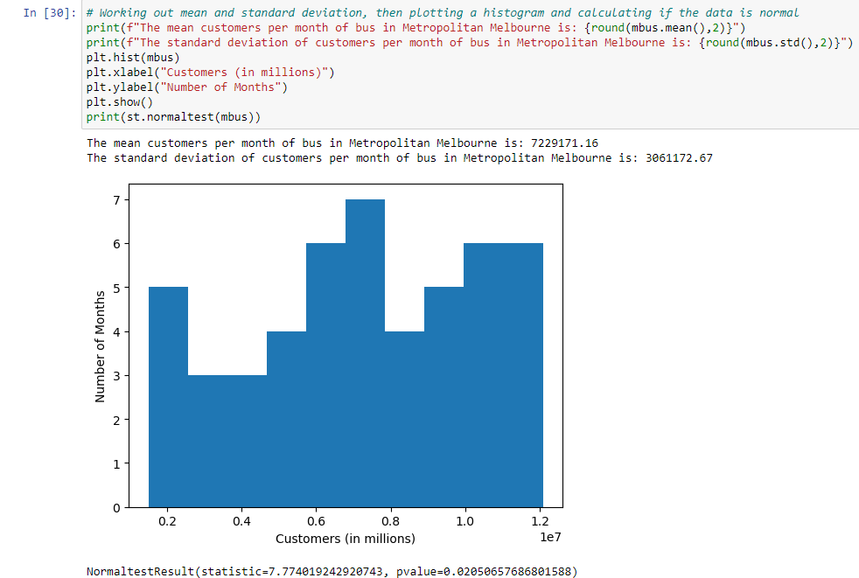
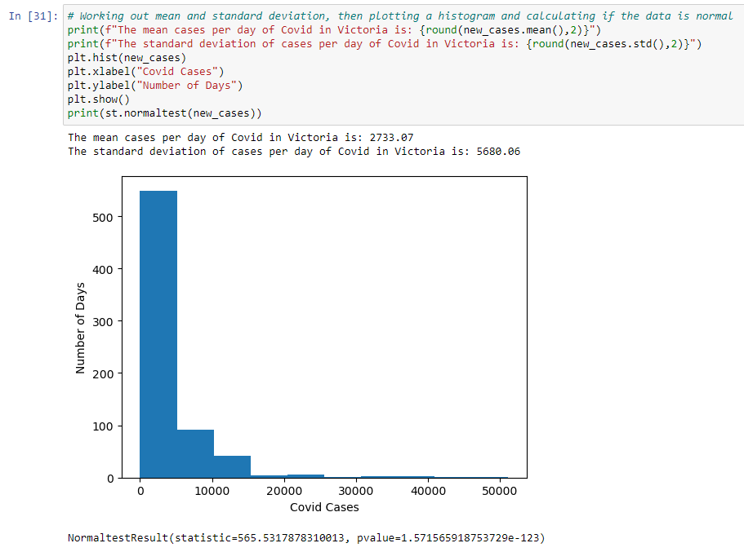
How has each of the different modes of public transport increased or decreased in usage in light of the pandemic?

Slide 16
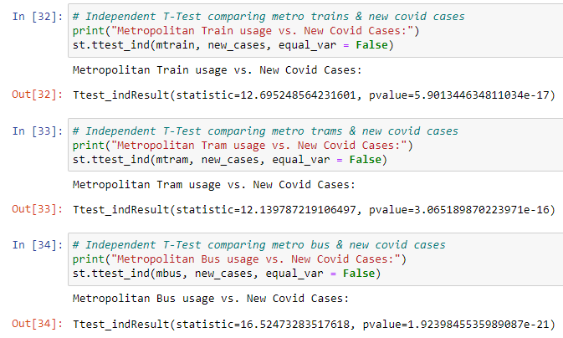
How has each of the different modes of public transport increased or decreased in usage in light of the pandemic?
We will accept the null hypothesis.
With the data assessed, we can not
with confidence state that there was
significant evidence that
the rise in Victorian COVID cases had
an impact on public transport usage
across the 3 modes of public transport
(Train, Tram and Bus) across
Metropolitan Victoria.
(Feel free to add)

Slide 17
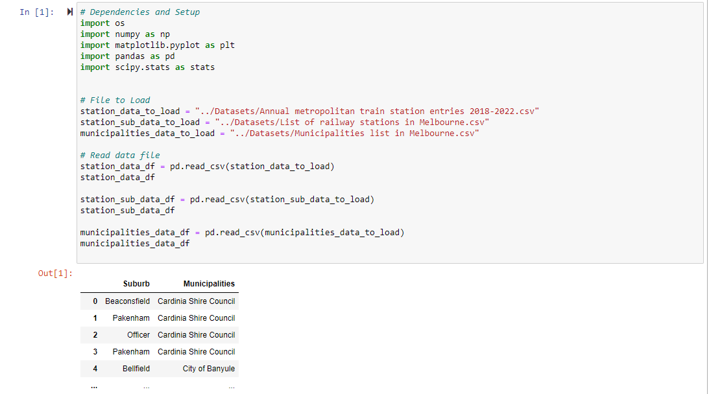
Which municipality saw the greatest change in public transport usage, and which station saw the greatest change in the City of Melbourne?

Slide 18
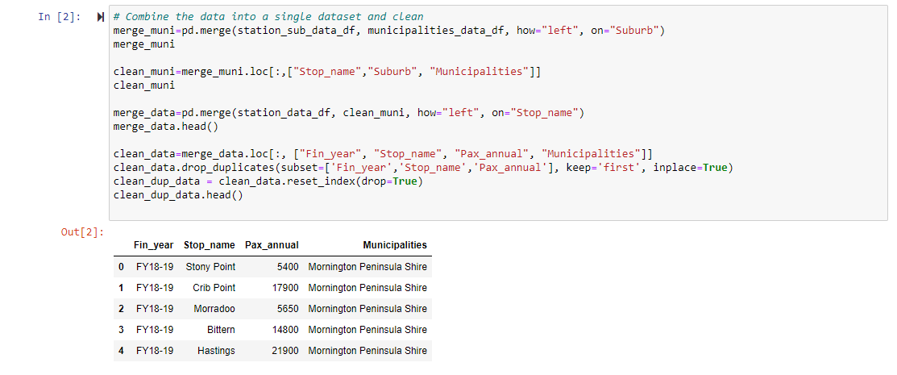
Which municipality saw the greatest change in public transport usage, and which station saw the greatest change in the City of Melbourne?

Slide 19
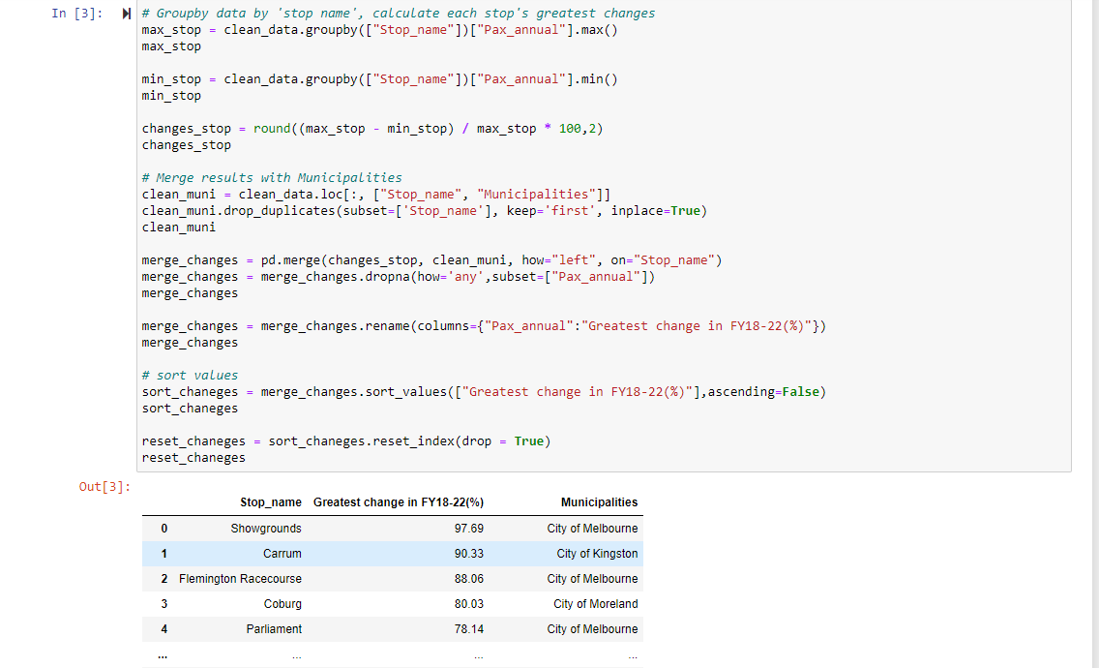
Which municipality saw the greatest change in public transport usage, and which station saw the greatest change in the City of Melbourne?

Slide 20
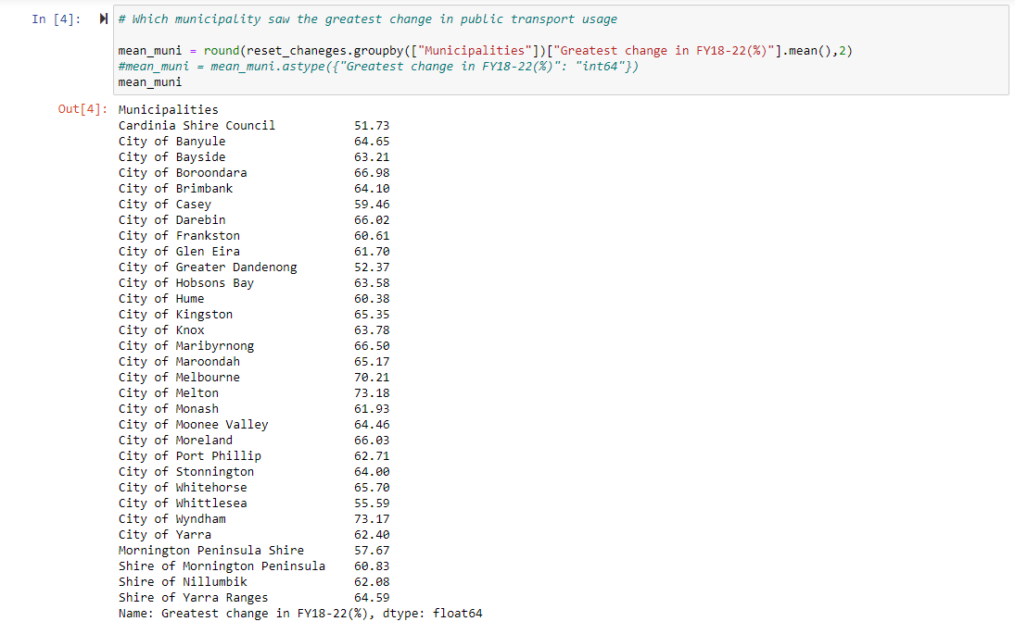
Which municipality saw the greatest change in public transport usage, and which station saw the greatest change in the City of Melbourne?

Slide 21
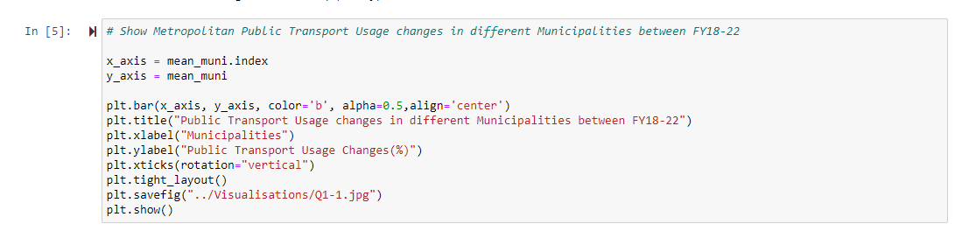
Which municipality saw the greatest change in public transport usage, and which station saw the greatest change in the City of Melbourne?

Slide 22
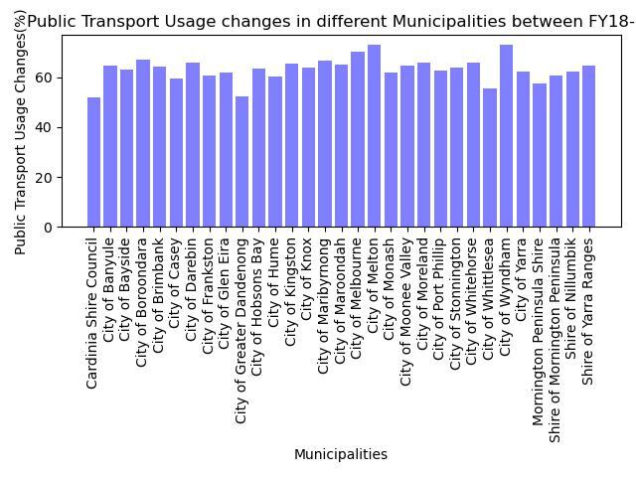
Which municipality saw the greatest change in public transport usage, and which station saw the greatest change in the City of Melbourne?

Slide 23
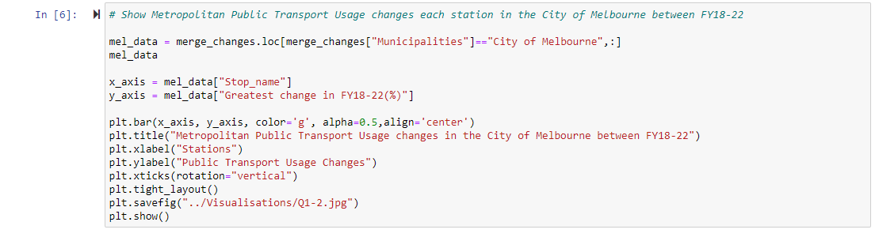
Which municipality saw the greatest change in public transport usage, and which station saw the greatest change in the City of Melbourne?

Slide 24
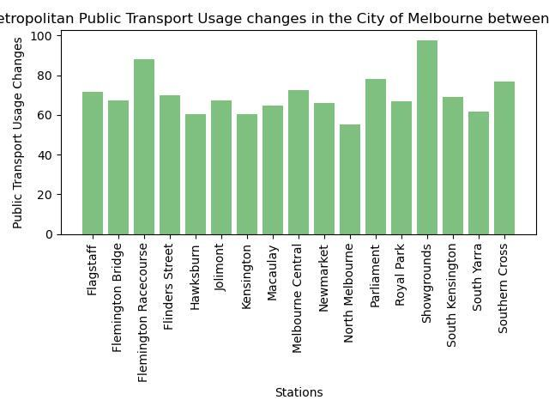
Which municipality saw the greatest change in public transport usage, and which station saw the greatest change in the City of Melbourne?

Slide 25
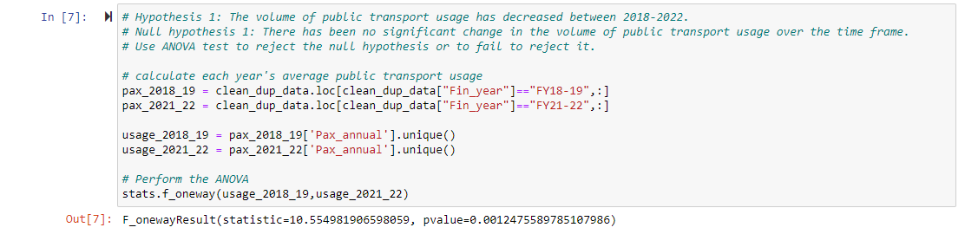
Which municipality saw the greatest change in public transport usage, and which station saw the greatest change in the City of Melbourne?

Slide 26
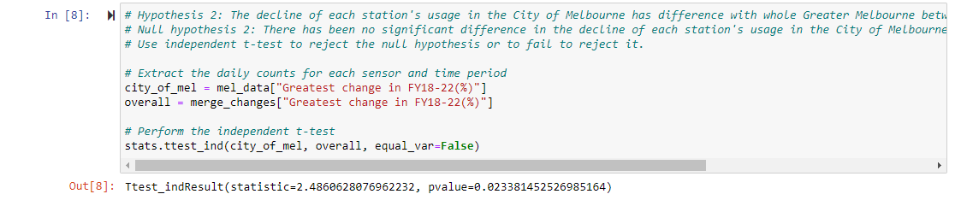
Which municipality saw the greatest change in public transport usage, and which station saw the greatest change in the City of Melbourne?

Slide 27
Which municipality saw the greatest change in public transport usage, and which station saw the greatest change in the City of Melbourne?
Public Transport Usage dropped around 60% between FY18-22. City of Melton, City of Wyndham and City of Melbourne have the biggest decrease.
In the City of Melbourne, Showgrounds and Flemington Racecourse have the greatest change.
The volume of public transport usage has decreased between 2018-2022. Also, the decline of the station's usage in the City of Melbourne more than the Greater Melbourne.

Slide 28
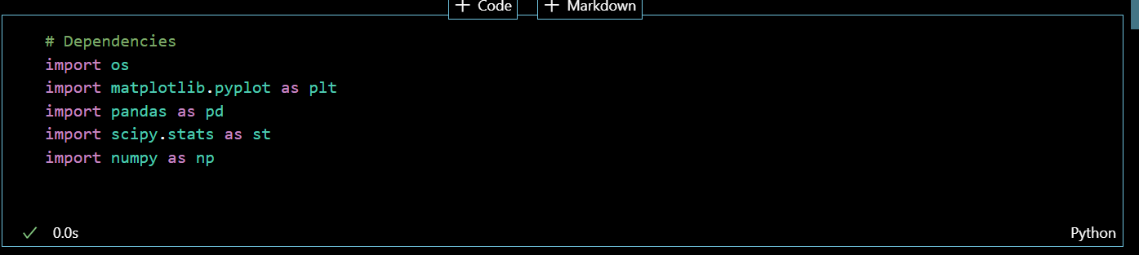
Did the pandemic affect the peak hours of train usage in Metropolitan Melbourne?

Slide 29
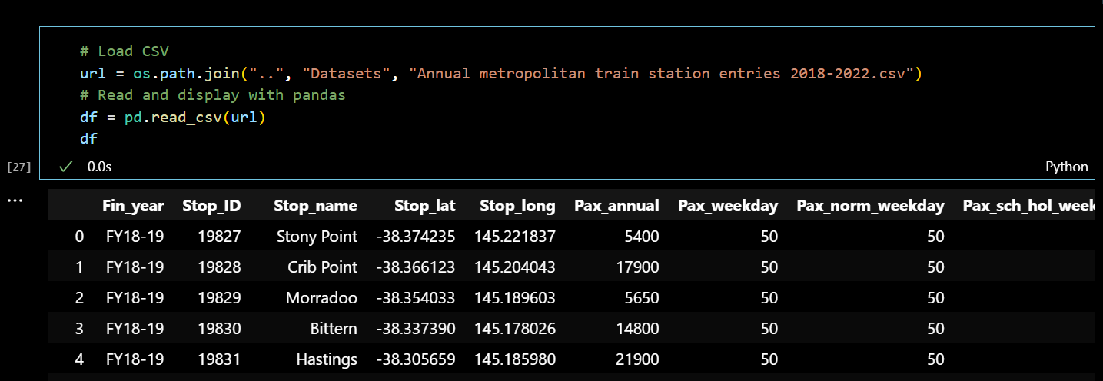
Did the pandemic affect the peak hours of train usage in Metropolitan Melbourne?

Slide 30
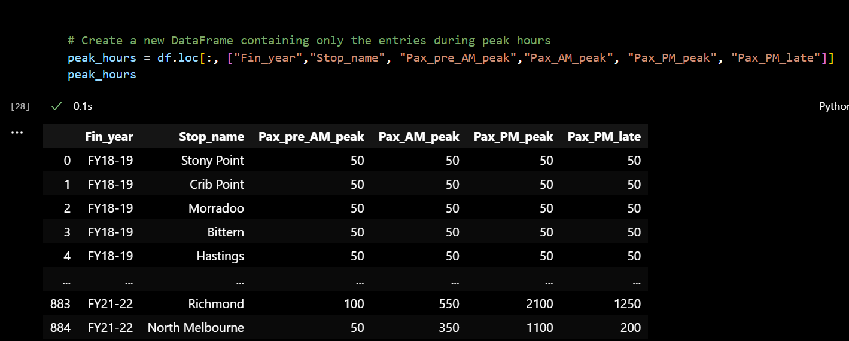
Did the pandemic affect the peak hours of train usage in Metropolitan Melbourne?

Slide 31
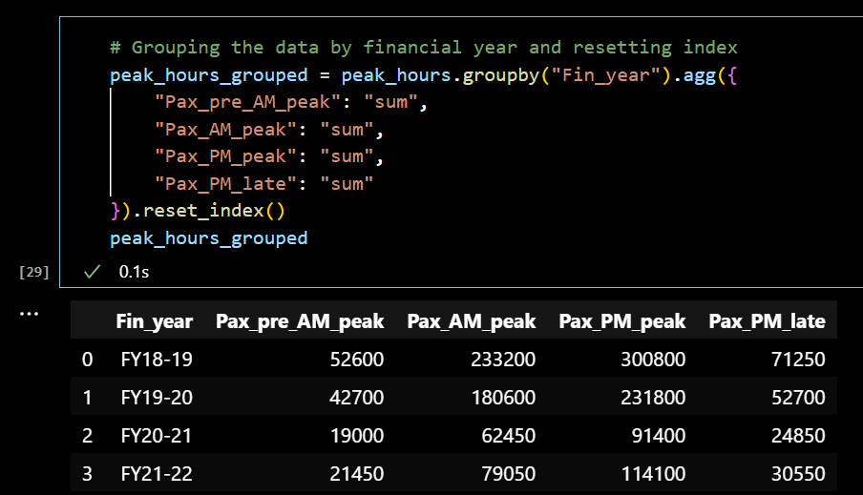
Did the pandemic affect the peak hours of train usage in Metropolitan Melbourne?

Slide 32
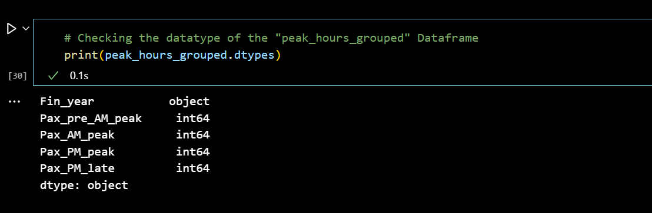
Did the pandemic affect the peak hours of train usage in Metropolitan Melbourne?

Slide 33
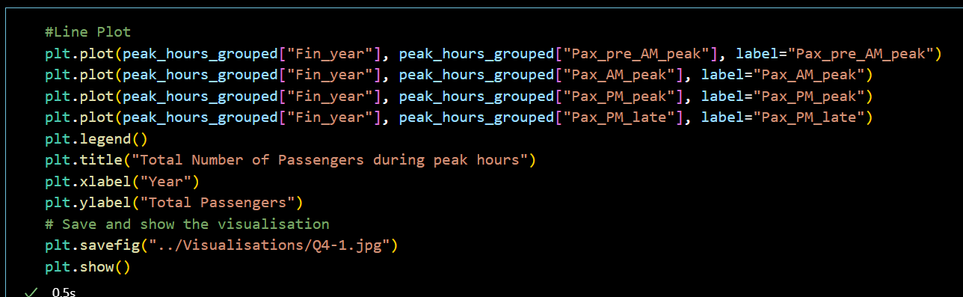
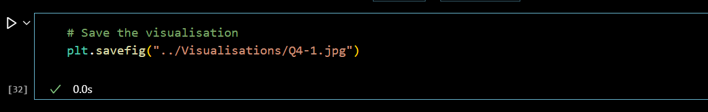
Did the pandemic affect the peak hours of train usage in Metropolitan Melbourne?

Slide 34
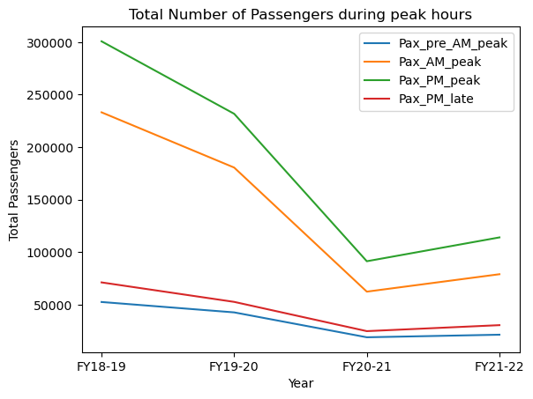
Did the pandemic affect the peak hours of train usage in Metropolitan Melbourne?

Slide 35
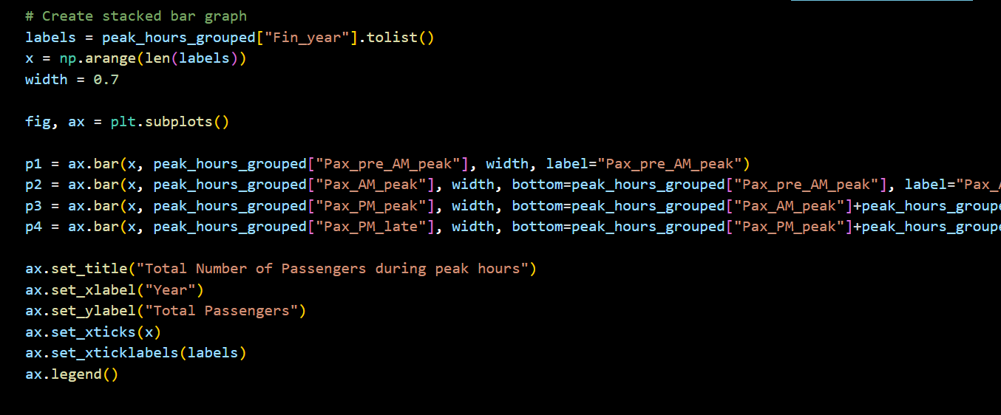
Did the pandemic affect the peak hours of train usage in Metropolitan Melbourne?

Slide 36
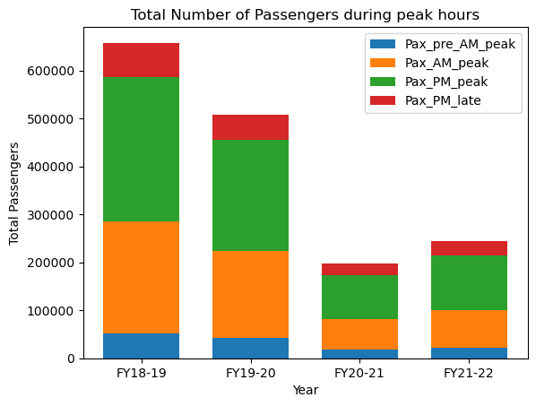
Did the pandemic affect the peak hours of train usage in Metropolitan Melbourne?

Slide 37
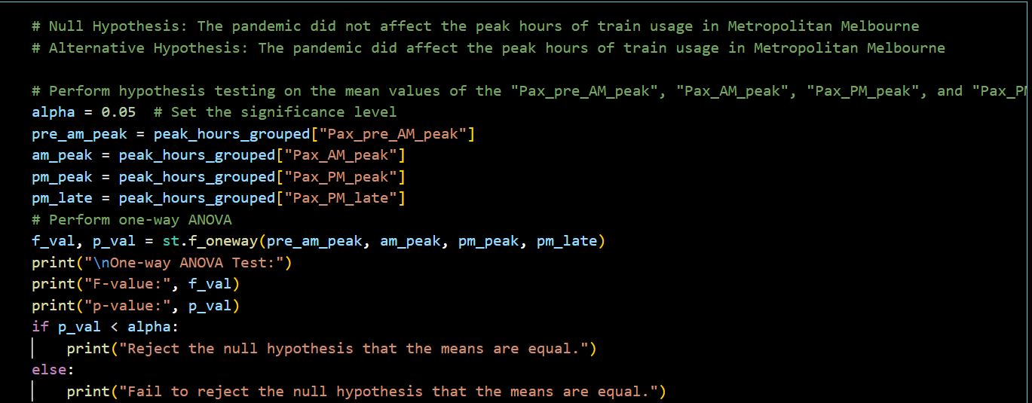
Did the pandemic affect the peak hours of train usage in Metropolitan Melbourne?

Slide 38
Did the pandemic affect the peak hours of train usage in Metropolitan Melbourne?
Conclusions (Manisha)

Slide 39
How has the volume of pedestrian traffic in Melbourne’s CBD evolved over the time frame?
Screenshots of code

Slide 40
How has the volume of pedestrian traffic in Melbourne’s CBD evolved over the time frame?
More code

Slide 41
How has the volume of pedestrian traffic in Melbourne’s CBD evolved over the time frame?
Visualisation 1

Slide 42
How has the volume of pedestrian traffic in Melbourne’s CBD evolved over the time frame?
Visualisation 2

Slide 43
How has the volume of pedestrian traffic in Melbourne’s CBD evolved over the time frame?
Statistical Analysis for Visualisation 1

Slide 44
How has the volume of pedestrian traffic in Melbourne’s CBD evolved over the time frame?
Statistical Analysis for Visualisation 2

Slide 45
OVERALL Conclusions
Manisha

